Slide 1
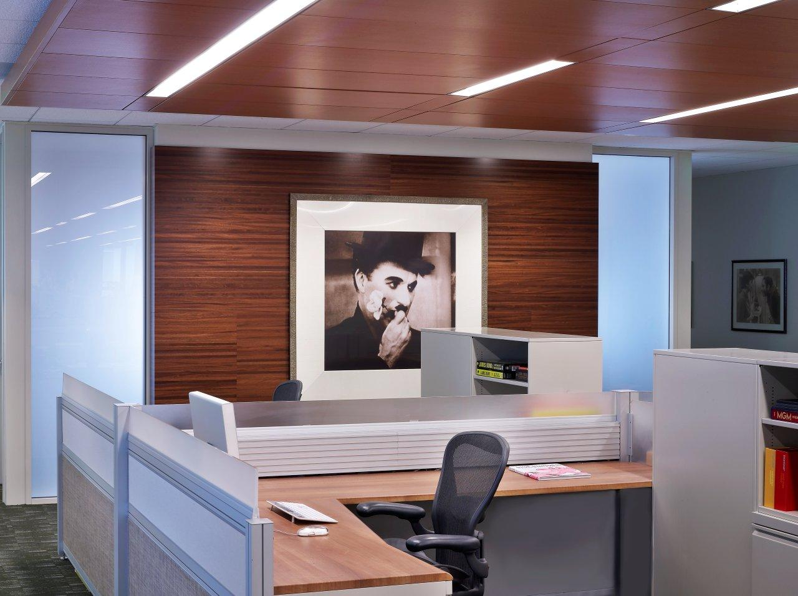

Slide 2
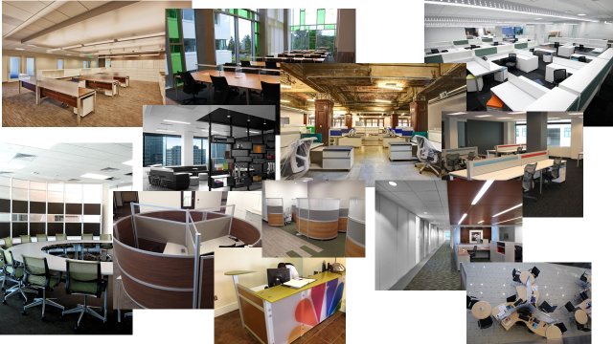

Slide 3
Fluidgroup Companies
Mid Plus Market
Open Plan
Highly Customizable
Unique
Chameleon like
Project Business
Mid-Market
Private Office/Boardroom Reception/Education
Healthcare/Govt
Light Open Plan
Budget Oriented
Day to Day Business

Slide 4
Fluidgroup Companies

Slide 5
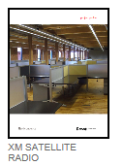

Slide 6
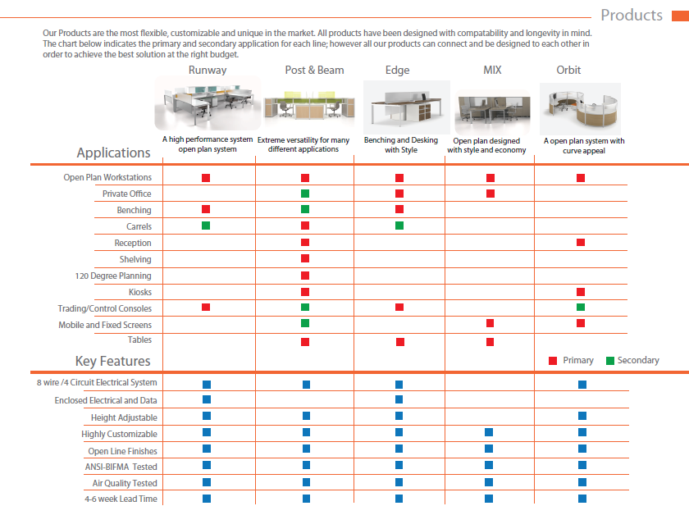

Slide 7
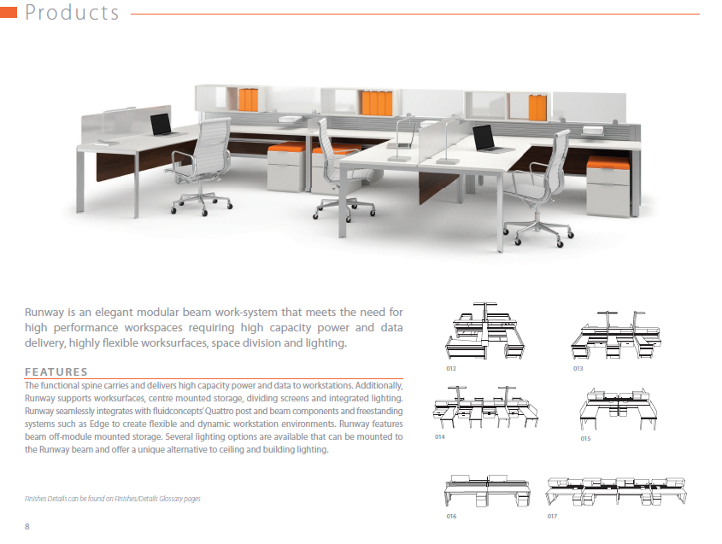
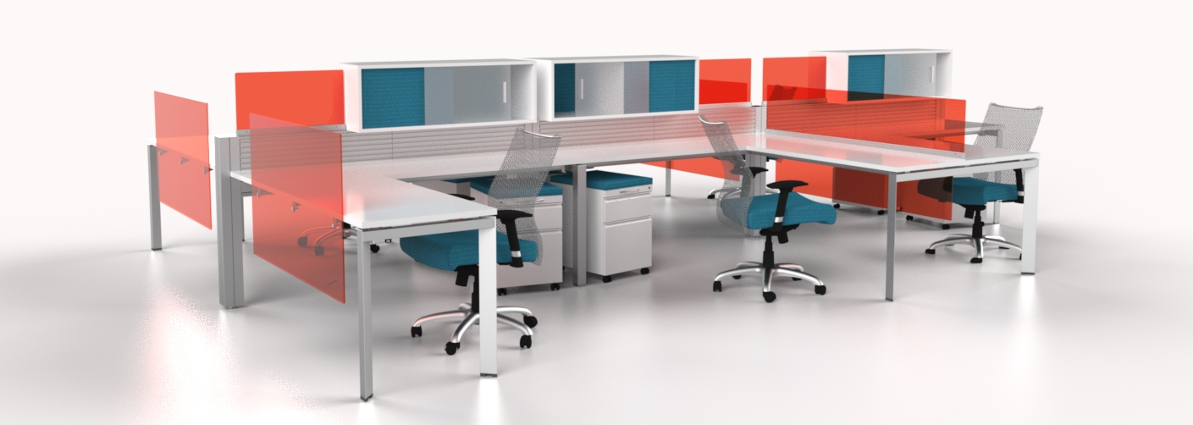
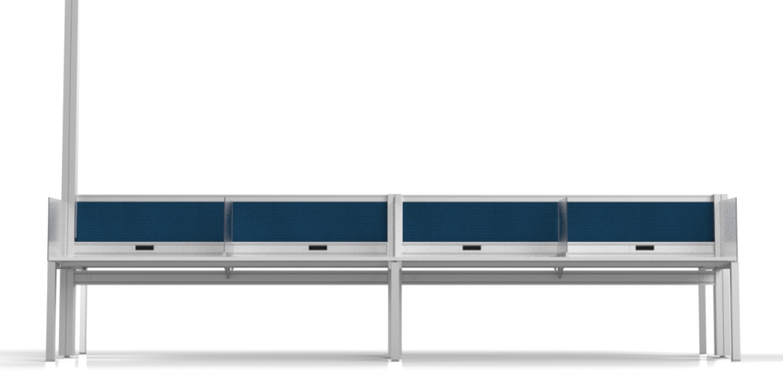
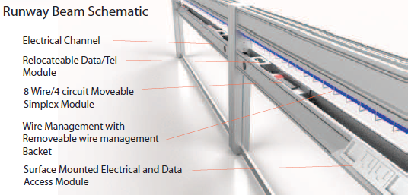
Runway

Slide 8
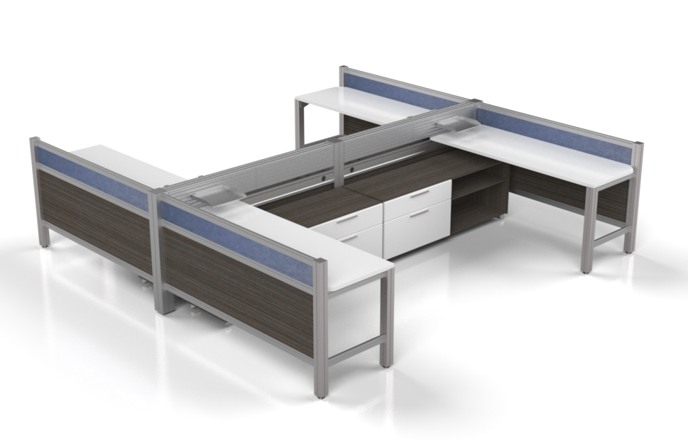
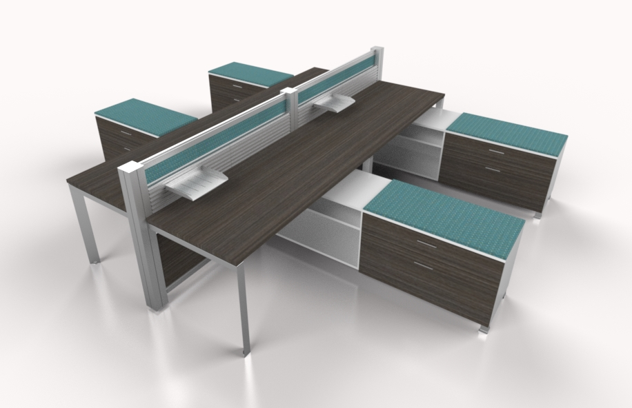
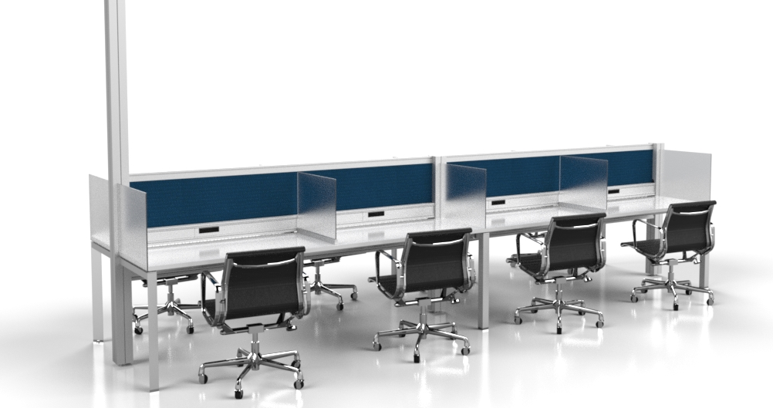
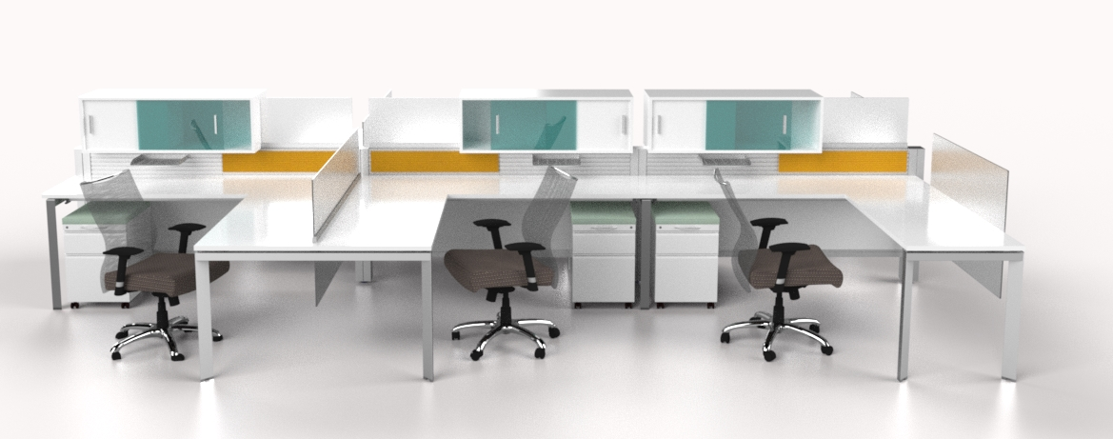
Runway concepts

Slide 9
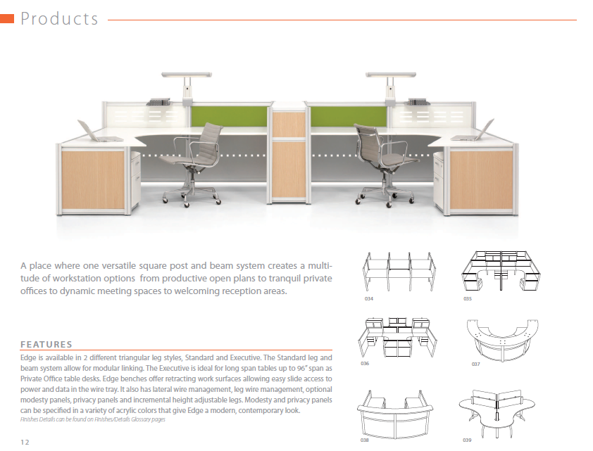
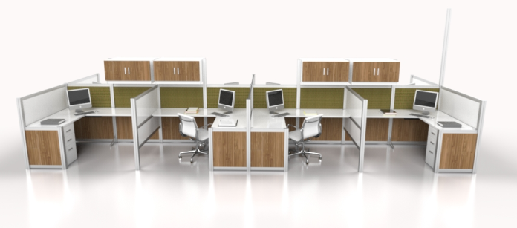
Post and Beam

Slide 10
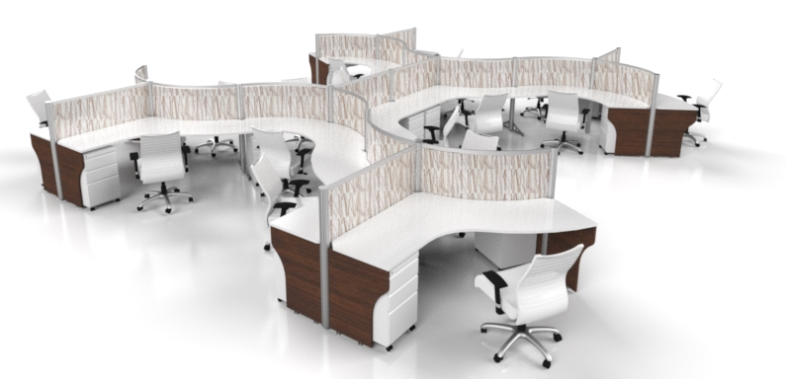
Post and Beam concepts

Slide 11
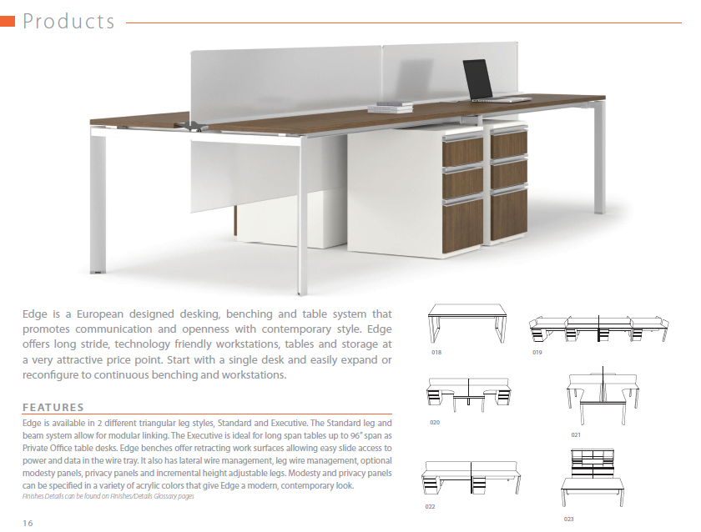
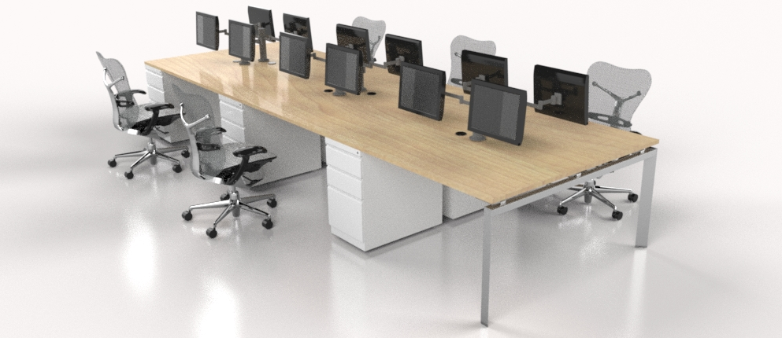
Edge

Slide 12
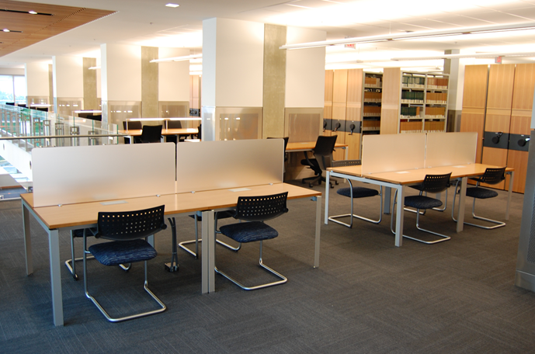
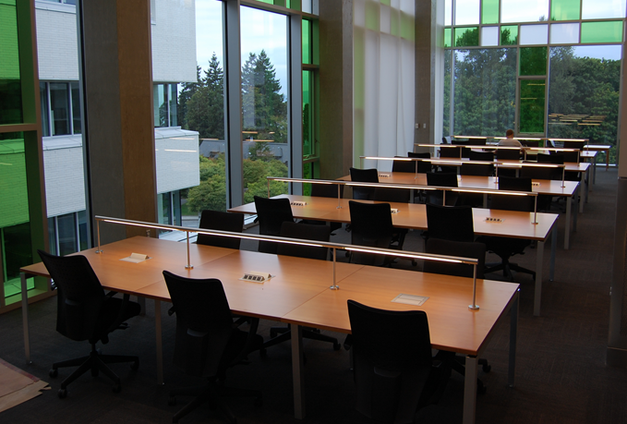
Edge concepts

Slide 13
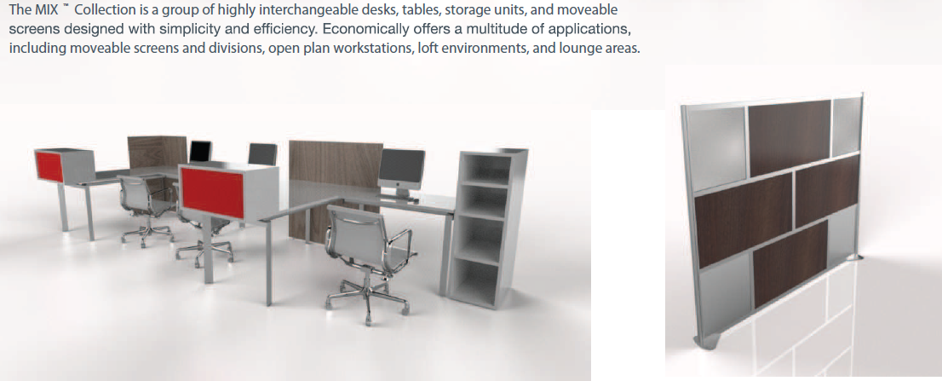
MIX

Slide 14
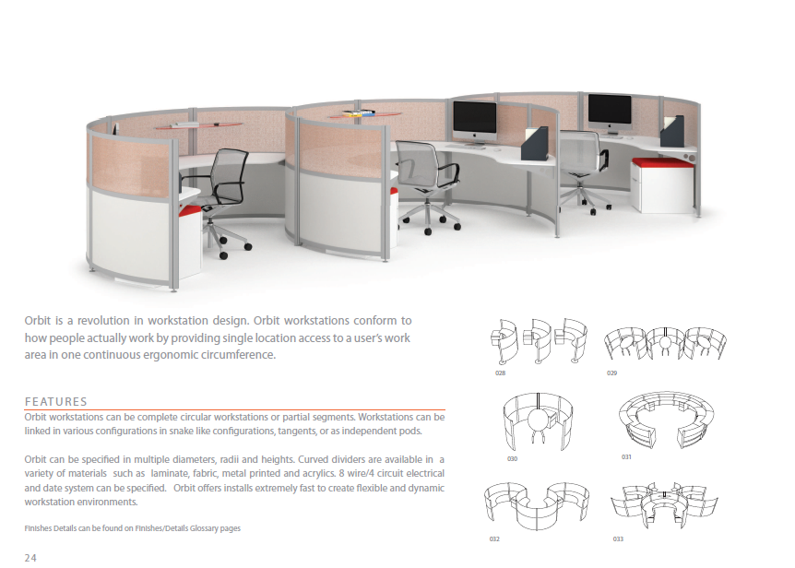
Orbit

Slide 15
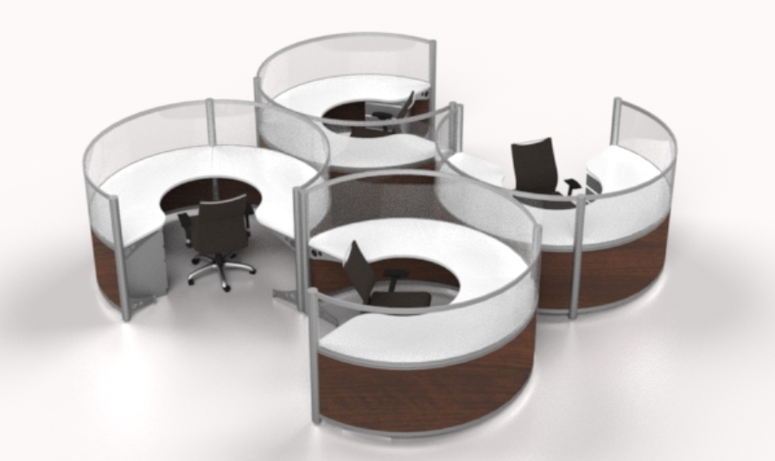
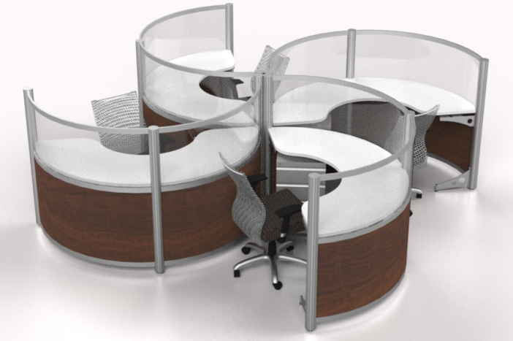
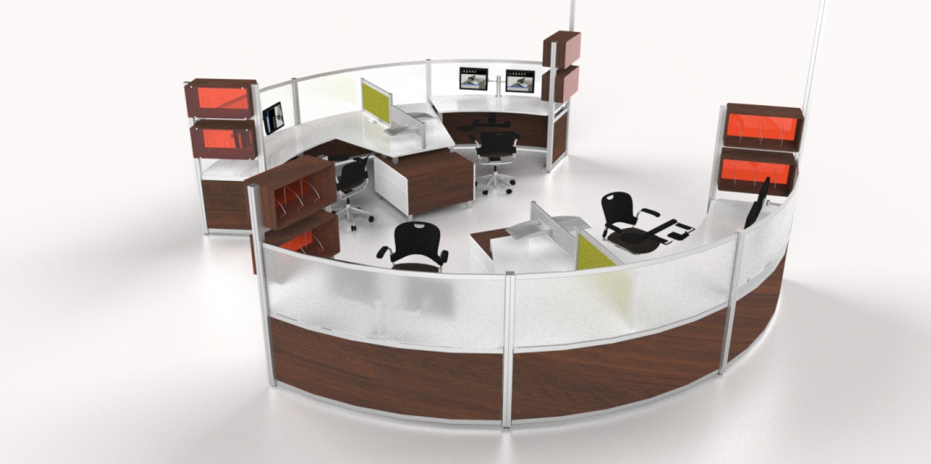
Orbit concepts

Slide 17
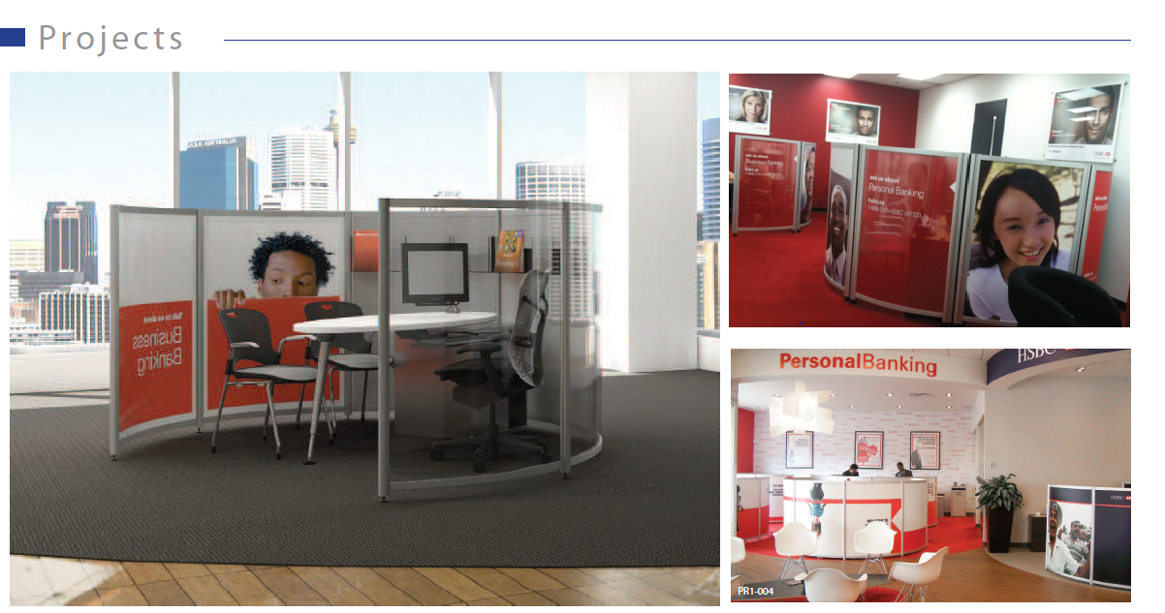

Slide 18
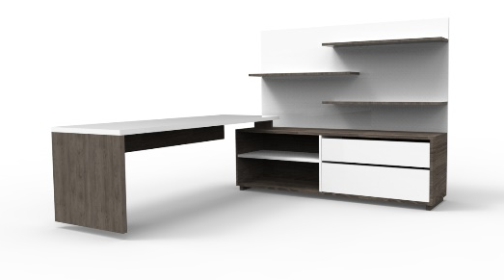
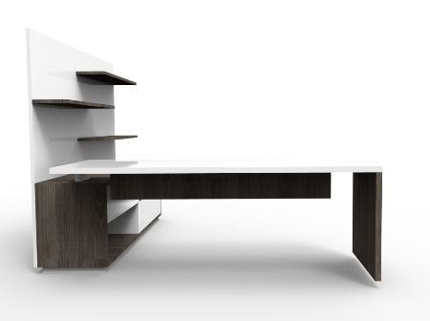
New Casegoods
Features
Architectural
1.5” Tops and Gables
Workwall Storage
Simplicity & Elegance

Slide 19
Let us do the work!
We will work closely with the dealer, designer and client
Conceptual Design Services (start from scratch)
Full Product Specification and Pricing
Full 3D Color Renderings
Development of 3D CAD files
Animation
Delivery & Installation
This means……
Reduced overhead costs and better profit margins!*
fluidconcepts has a specialized team of industrial and interior designers to add design value!
On average order proposals takes 6-8 hours at an approximate cost of $300-$500 – this is a complimentary service
fluidconcepts does not typically do the upfront space planning. This is provided by the dealer or designer

Slide 20
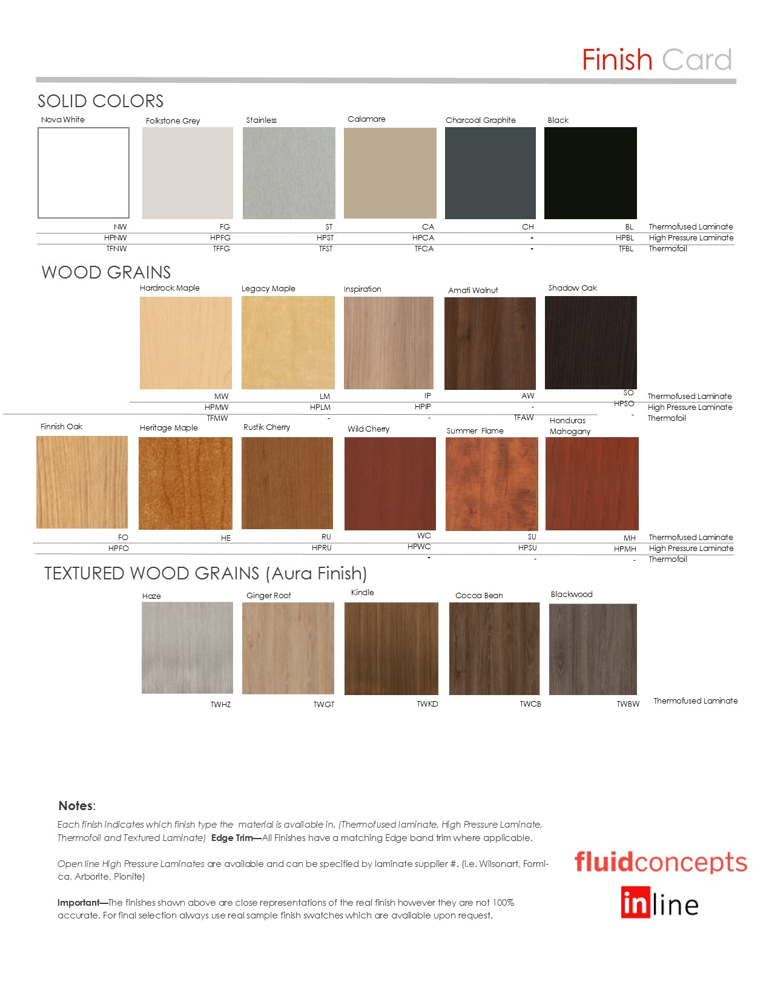

Slide 22
Let’s be Environmental!
82% overall recycle content
Compliant with
ANSI/BIFMA X7.1-2007 LEEDR EQ Credit 4.5
& GreenGuard compliant.

Slide 23
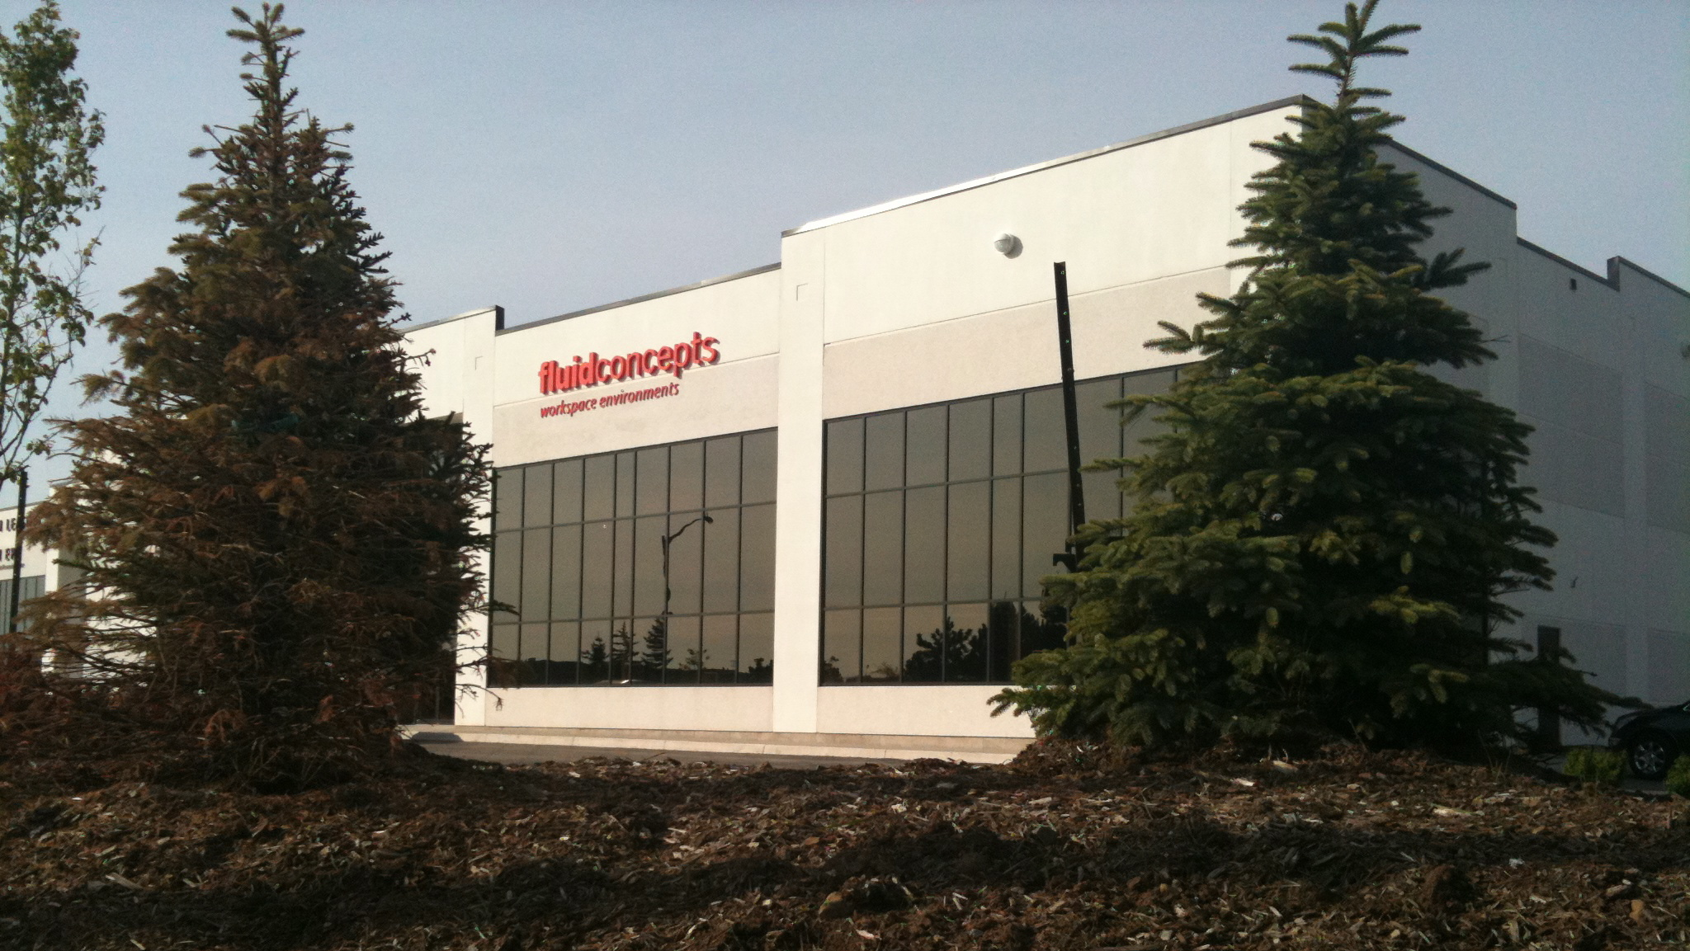
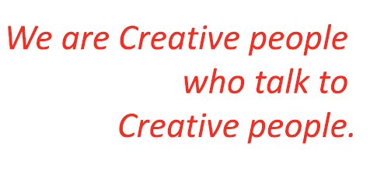
fluidconcepts was created in 2000
Who are we - designers, marketers and manufactures of alternative contract furnishings
Over 20,000 sq ft of showroom space through out Canada and the United States
Our manufacturing and distribution facility is located just outside Toronto, Ontario
The staff is an experienced collective from Knoll, Teknion, Inscape, Spec and Tayco
We offer complete Design, Product Development and Manufacturing Services (n/c)
Rapid Growth pattern of 25-30% from 2009 to present
Result – Awards such as ‘Canada’s 100 Fastest Growing Companies’*- Profit Magazines
Core target audience is Architects, Designers and end users seeking personalized solutions at affordable prices

Slide 24
For all things Fluid … WWW.fluidgroup.com

